Slide 1

An Android Application For Word Suggestion
Prepared By :
Abid Al Hossain
Denesh Barua Pantho
Fahad Bin Aziz Nabil
A WORD SUGGESTION APP

Slide 2
Core Features:
Customizable Word Length: Users can increase or decrease word size by adding or removing character boxes.
Letter Control: Include or exclude specific letters in any position of the word.
Objective:
To create a user-friendly app that suggests suitable words for games like Wordle, poetry creation, and more.

Slide 3
Our Vision
Vision :
Our app aims to provide an interactive, simple, and efficient platform for users to explore words creatively and strategically.
Why It Matters ?
Enhances Creativity: Supports poetry, writing, and wordplay.
Boosts Strategy: Offers a competitive edge in word games.
Educational Impact: Builds vocabulary and strengthens spelling skills.

Slide 4
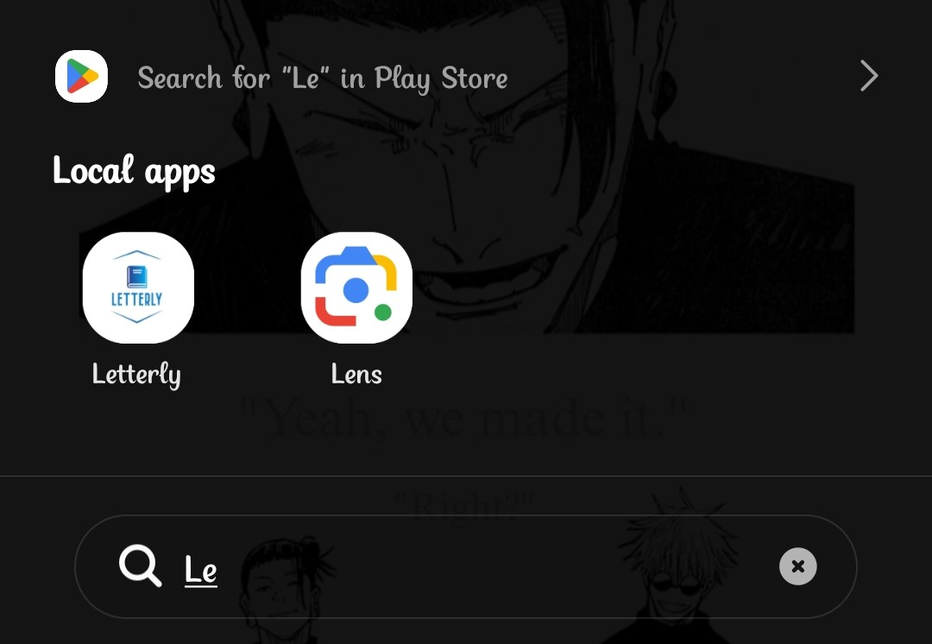
This is our “Letterly” App icon

Slide 5
This is our “Letterly” App icon

Slide 6
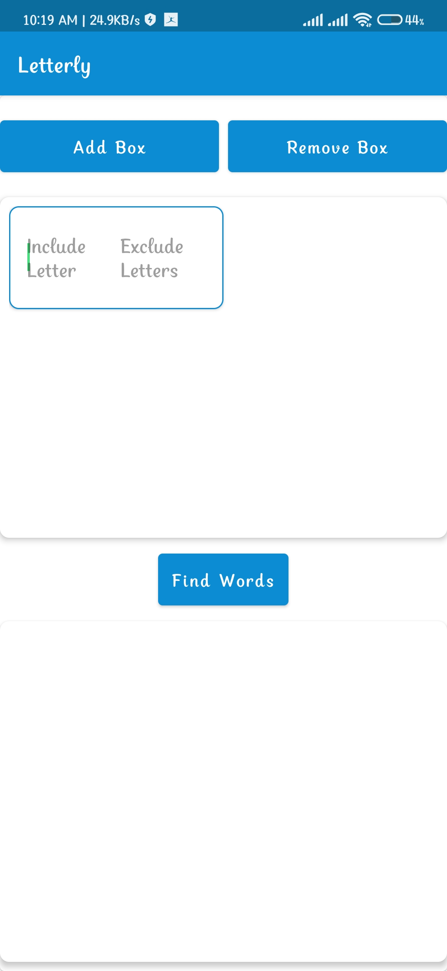

Slide 7
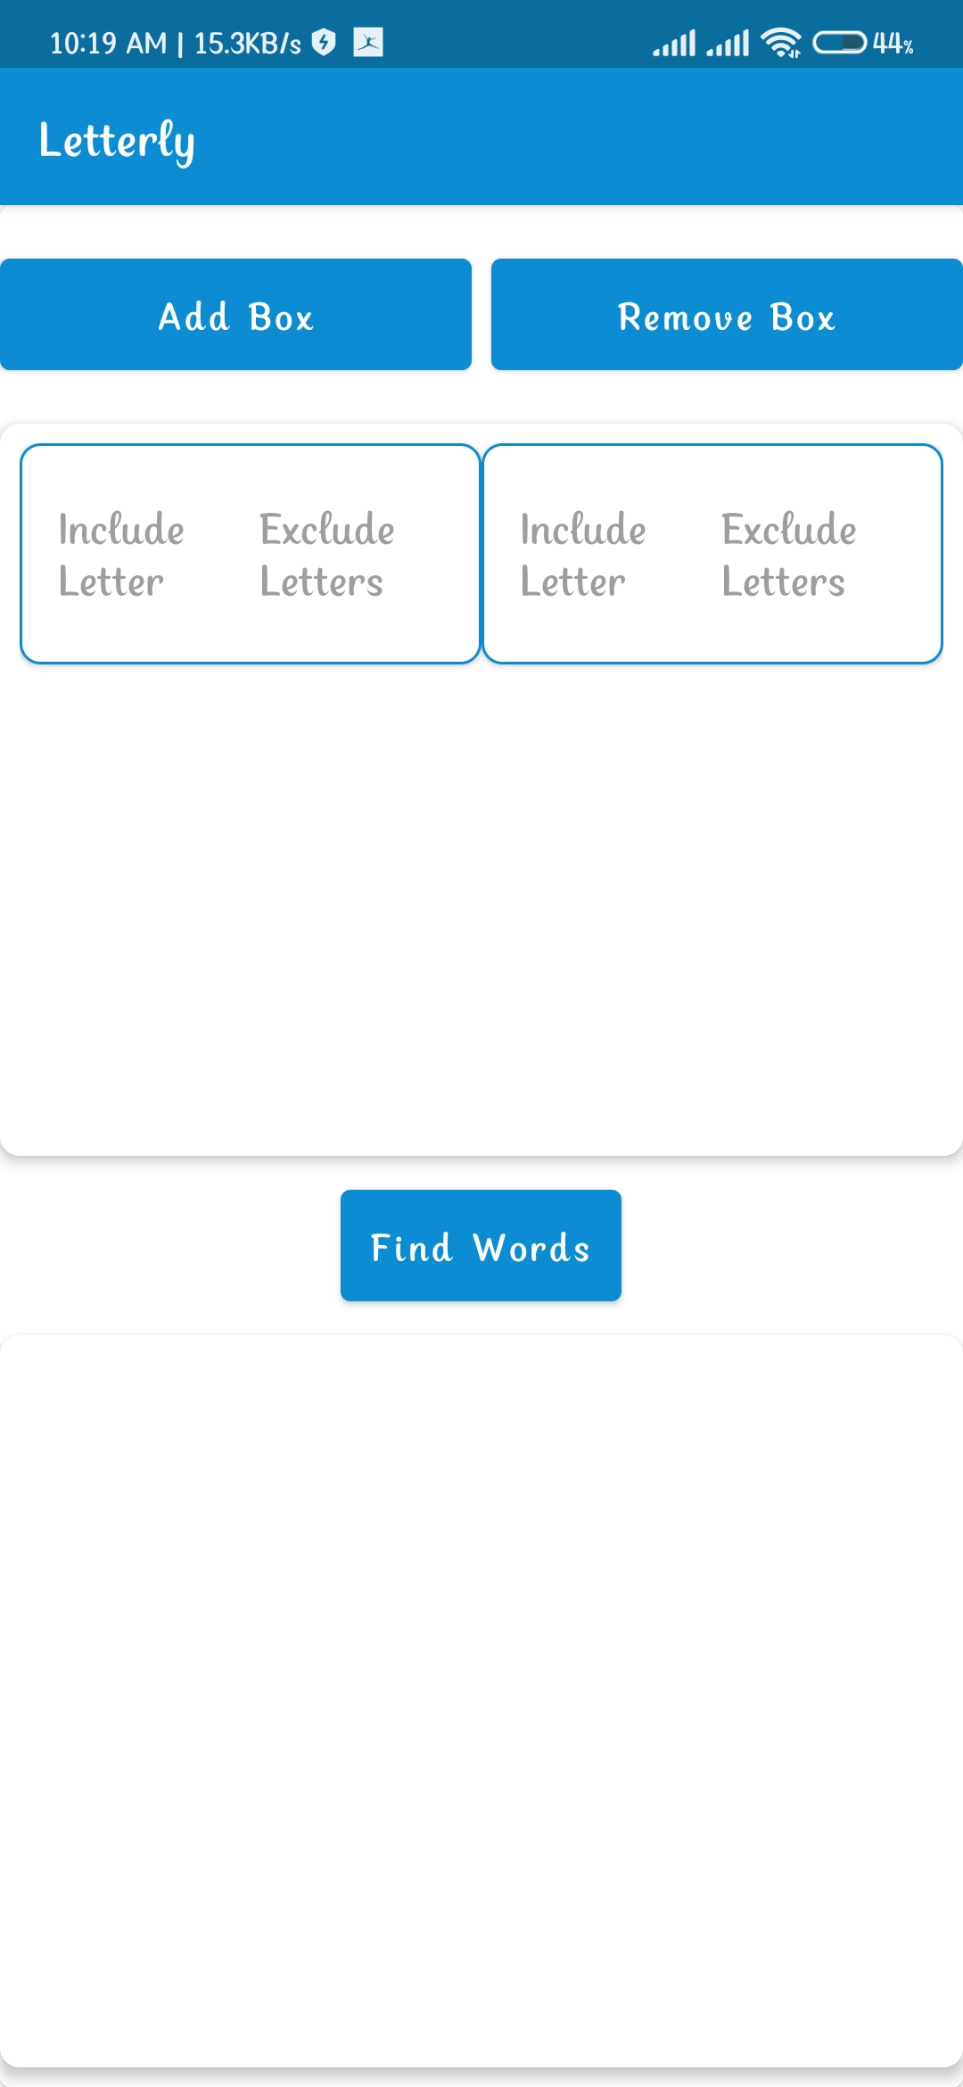

Slide 8
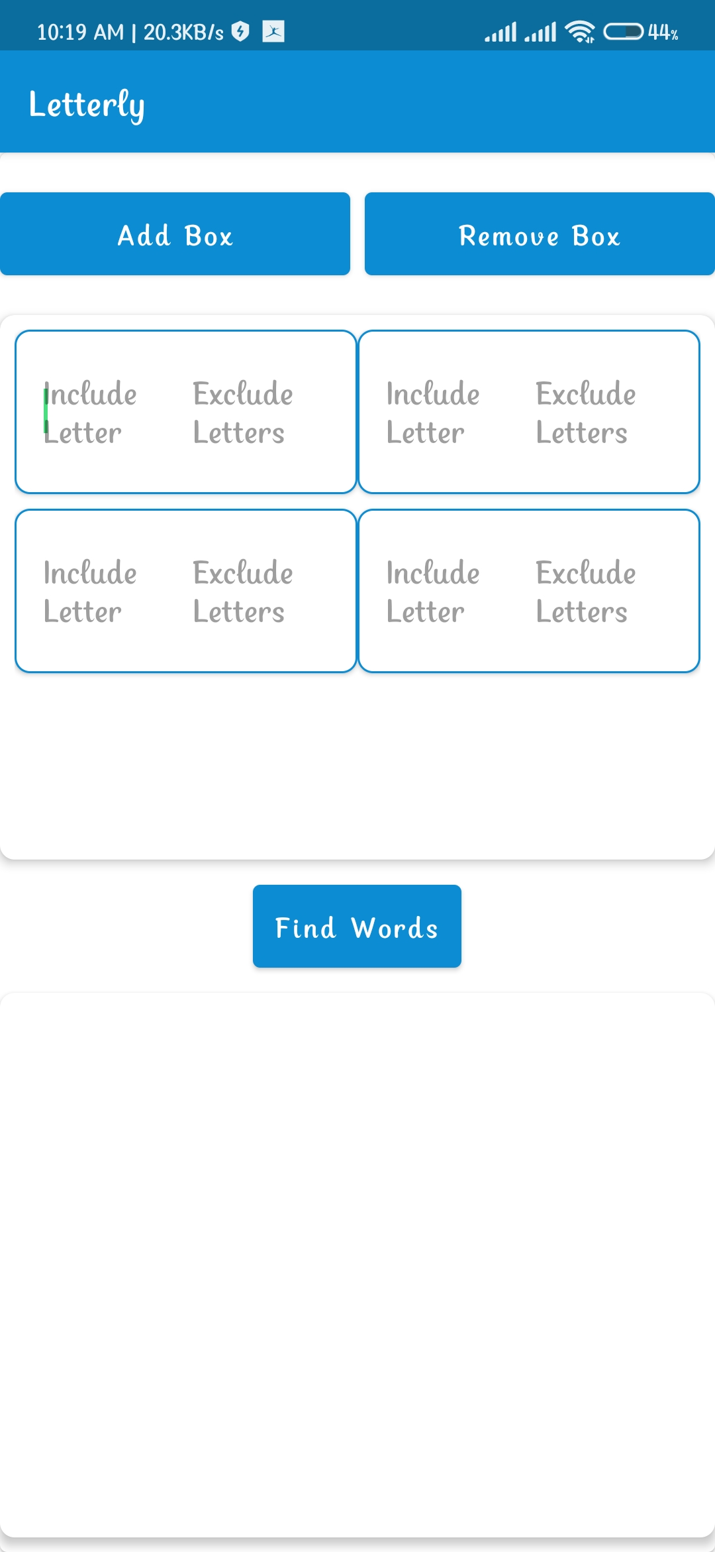
Users can add boxes dynamically based on word size.

Slide 9
Users can add boxes dynamically based on word size.

Slide 10
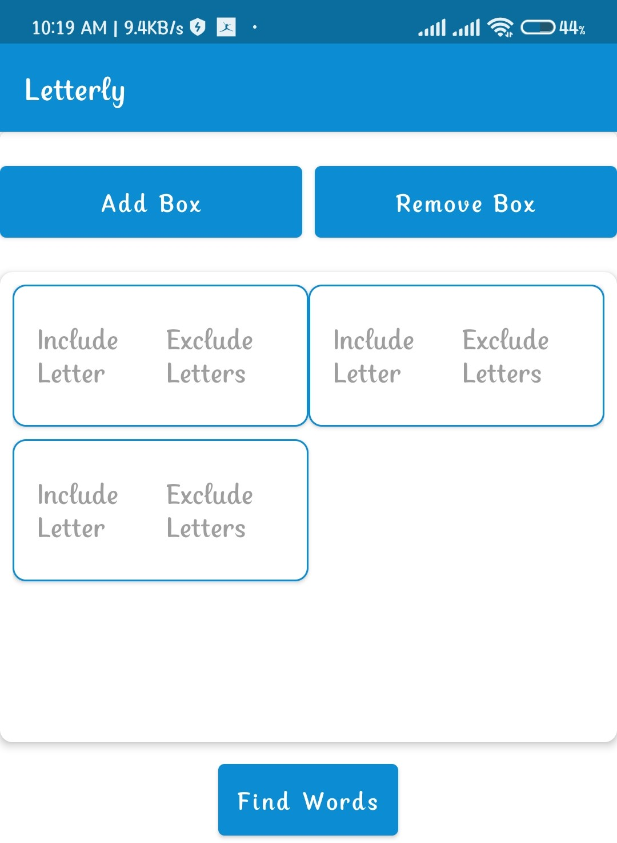
Users can remove boxes dynamically too by clicking the ‘Remove Box’ button.

Slide 11
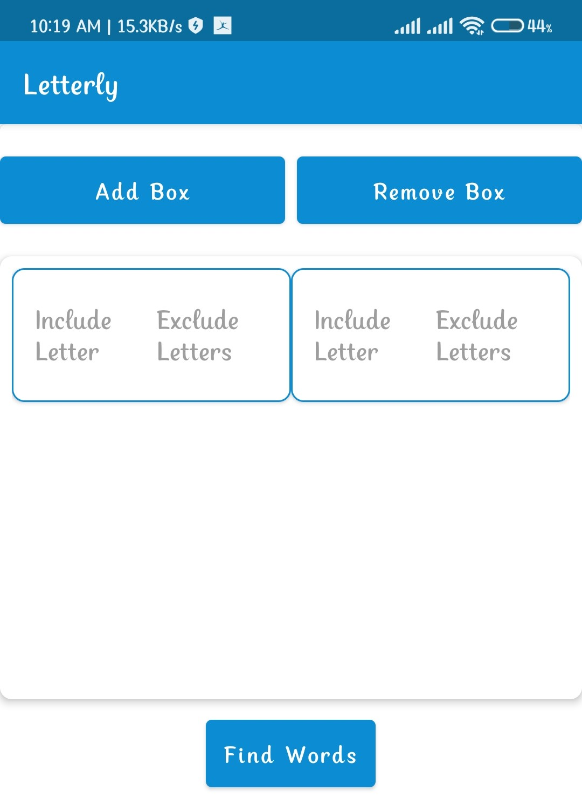

Slide 12
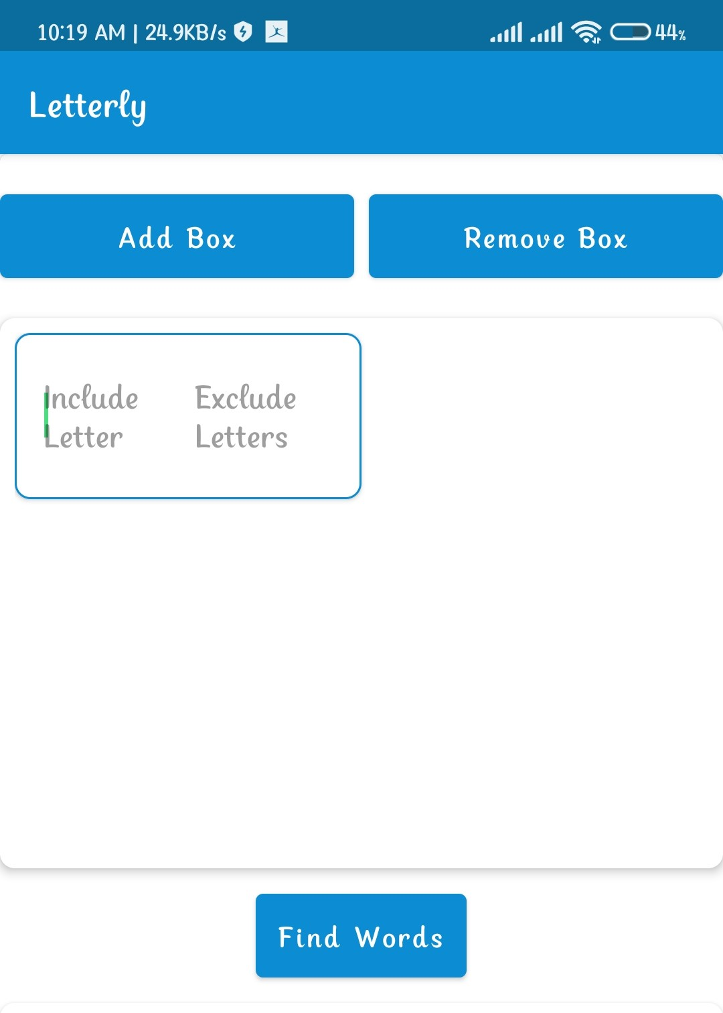

Slide 14
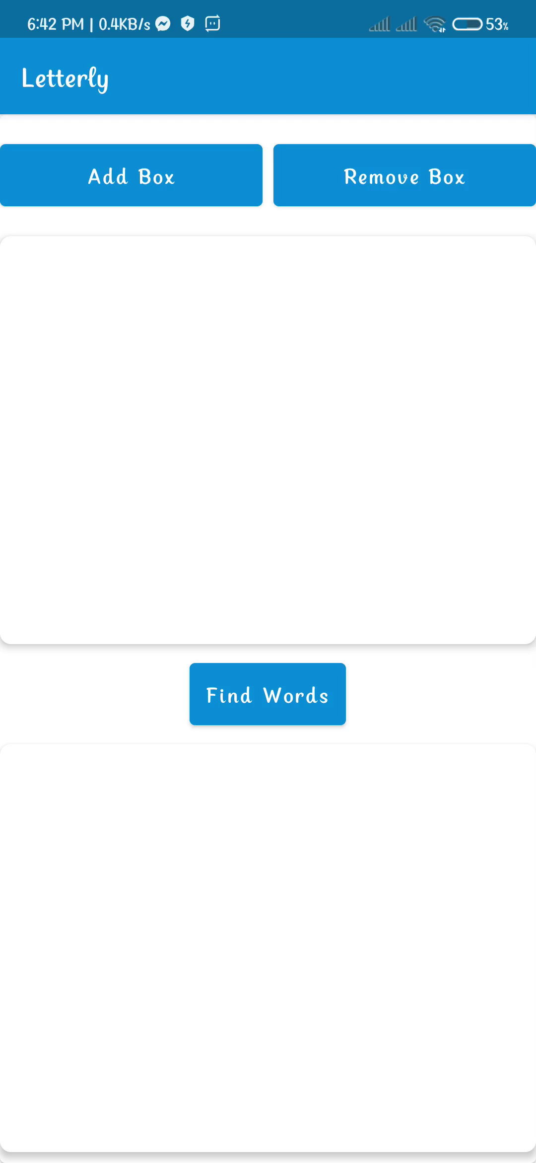
Users can input multiple letters separated by commas

Slide 15
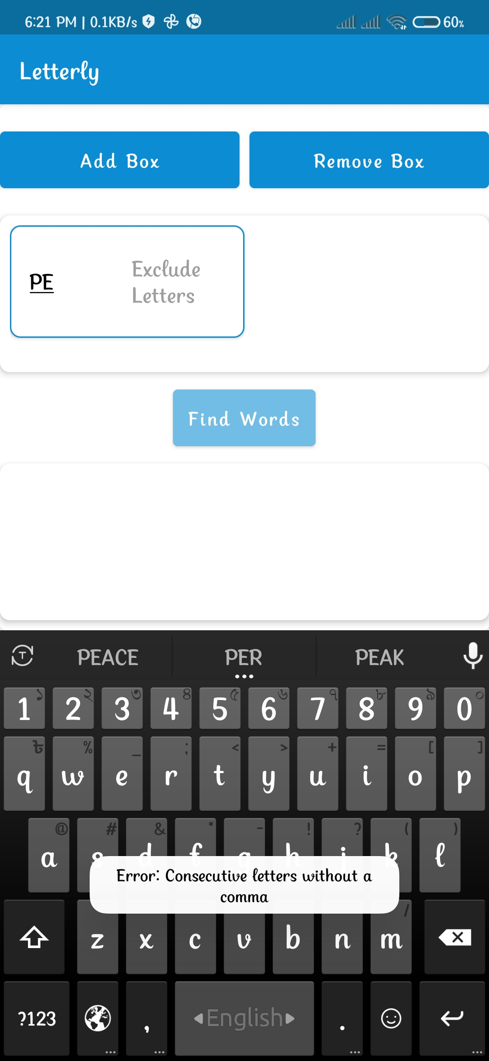
Two letters without comma will give error notification.

Slide 16
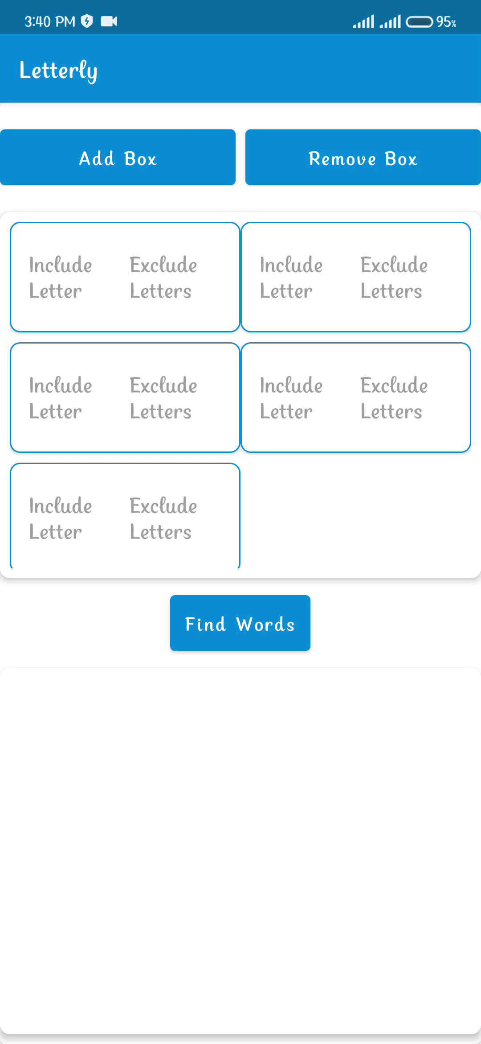
Input Letter
By Clicking 'Find Words’ Button, user can see the words matching letter positions in the boxes.
Suggested Words

Slide 17
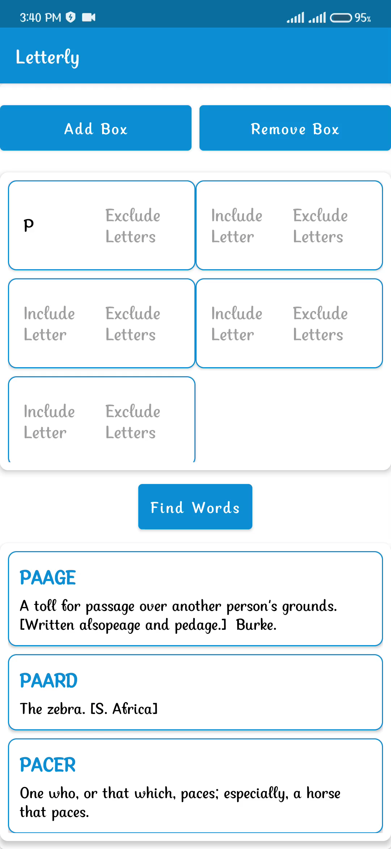
Starts with ‘P’
The words will be shown according to the position of letters or by exact match.
Ends with ‘E’
Suggested Words

Slide 18
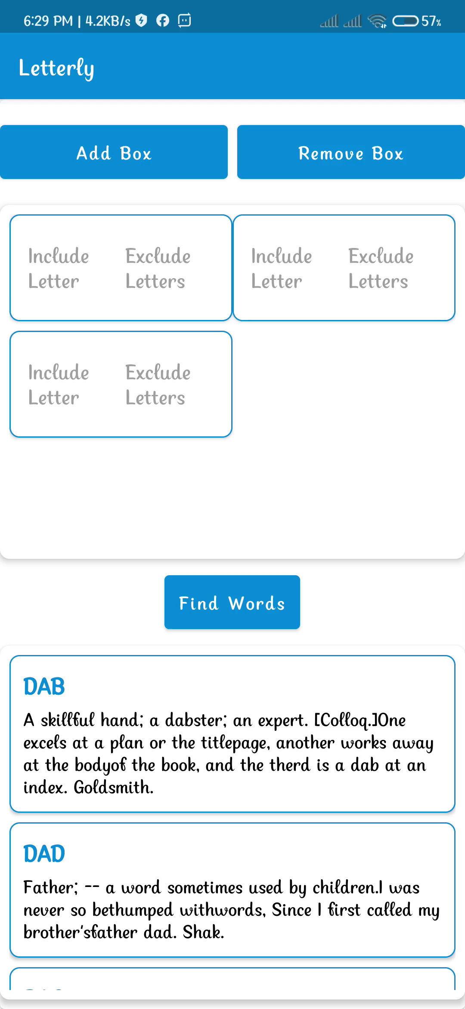
Users can mark letters to exclude, ensuring they won't appear in specific positions.
Words that Start with “D/H” and excludes “I” at the end

Slide 19
Thank You

